Slide 1

Team 4
Global Outbound and Inbound Travel
Raksha Israni
Juilee Patil
Dristi Dani
Ashwin Kuchibotla

Slide 2
Objectives
Analyse trends in outbound and inbound tourism in the USA
Identify seasonal variations and long-term trends in tourism data
Explore the correlation between tourism trends and economic indicators
Forecast future tourism patterns using time series analysis techniques

Slide 3
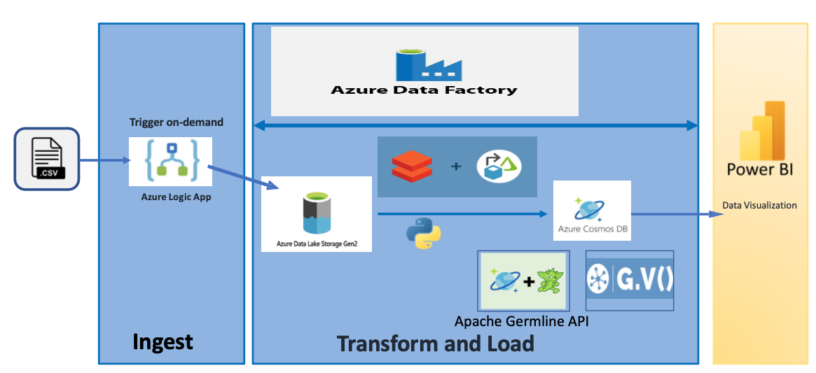
Architecture Diagram

Slide 4
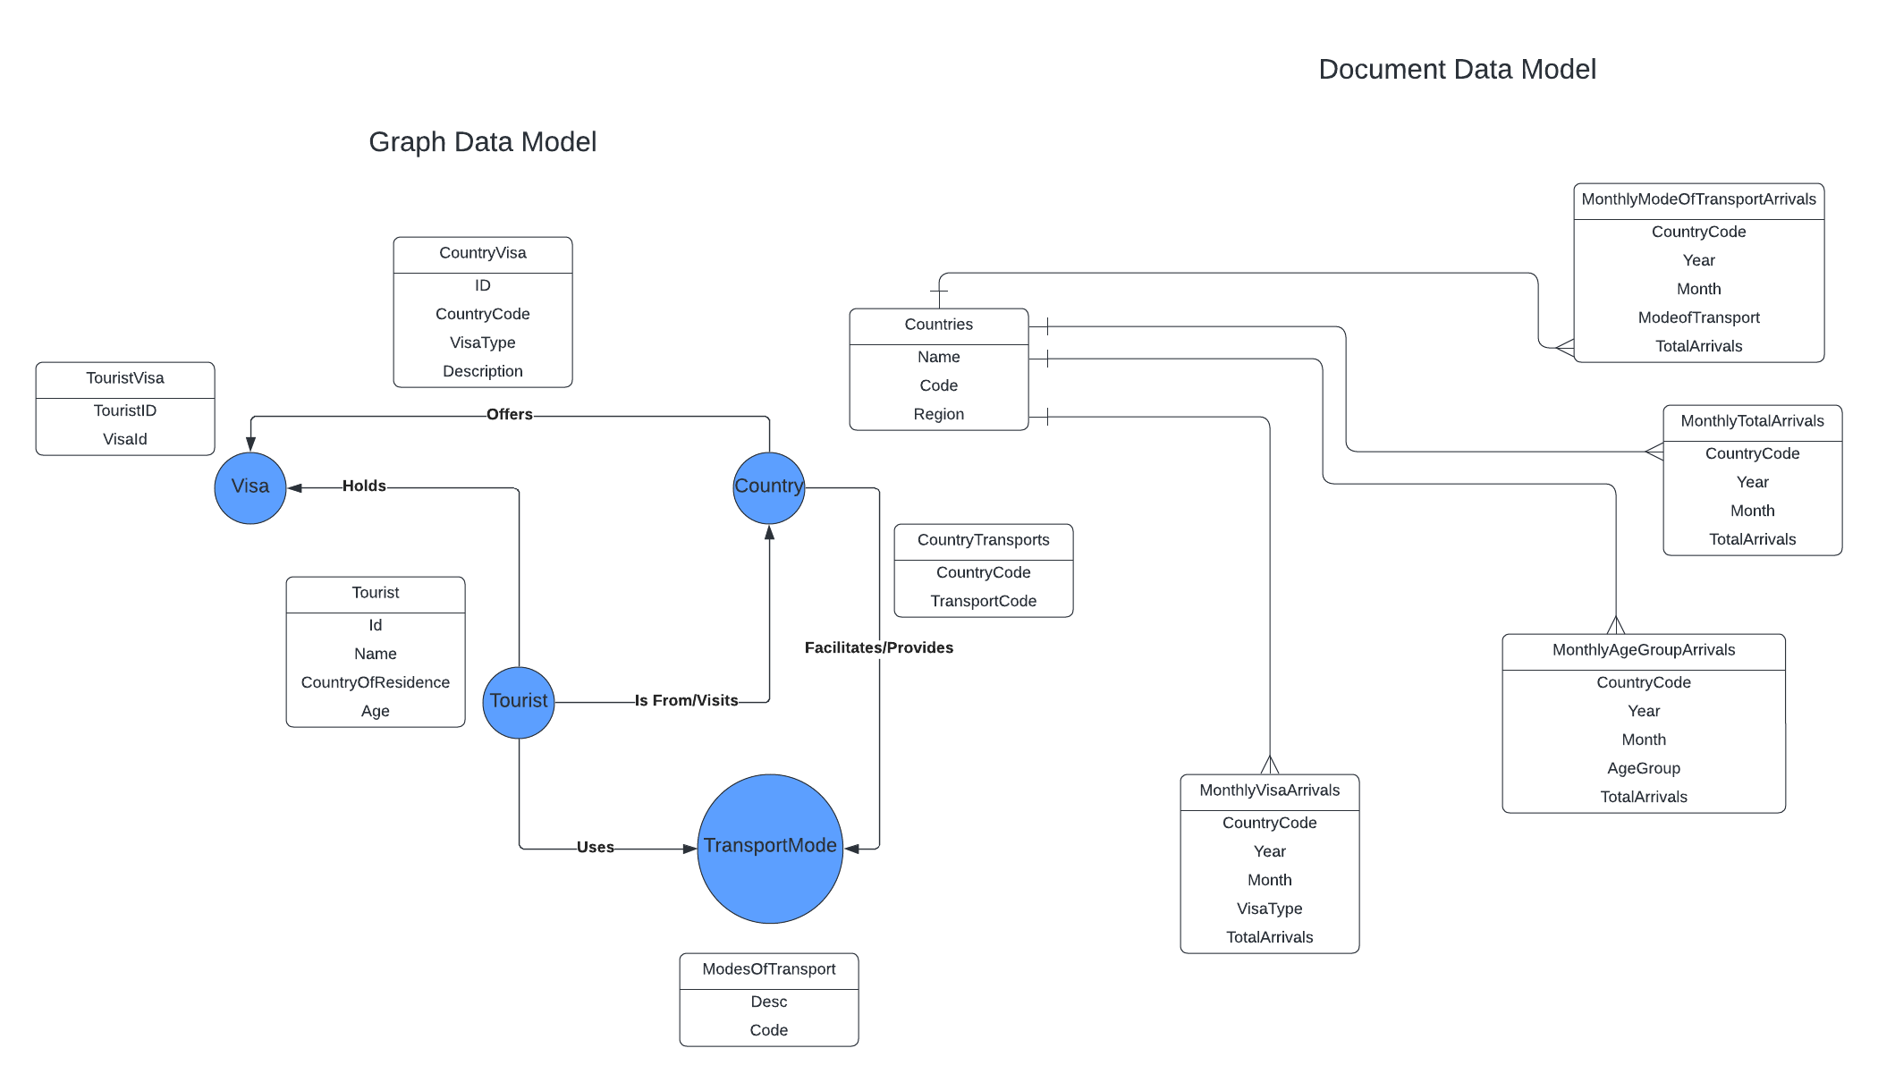
Entity Relationship Diagram

Slide 5
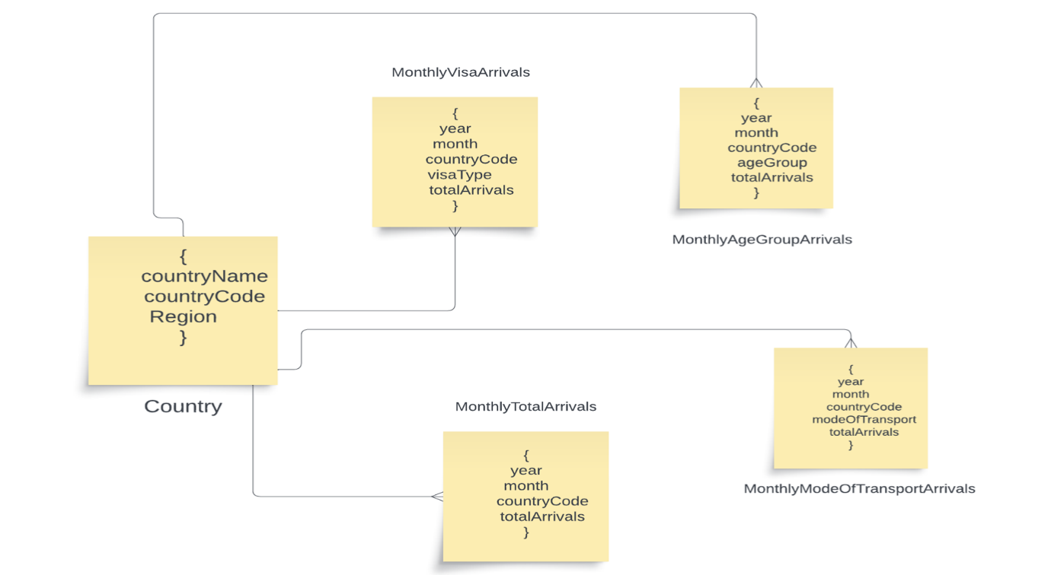
Azure Cosmos DB – Document Data Model

Slide 6
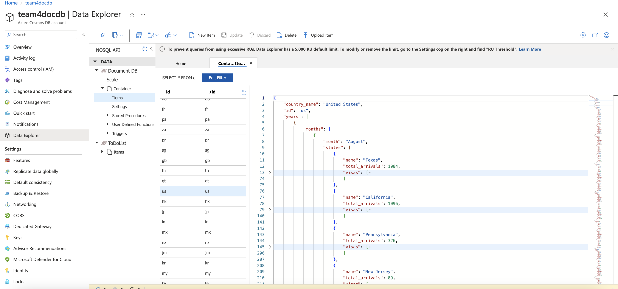
Azure Cosmos DB – Document Data Model

Slide 7
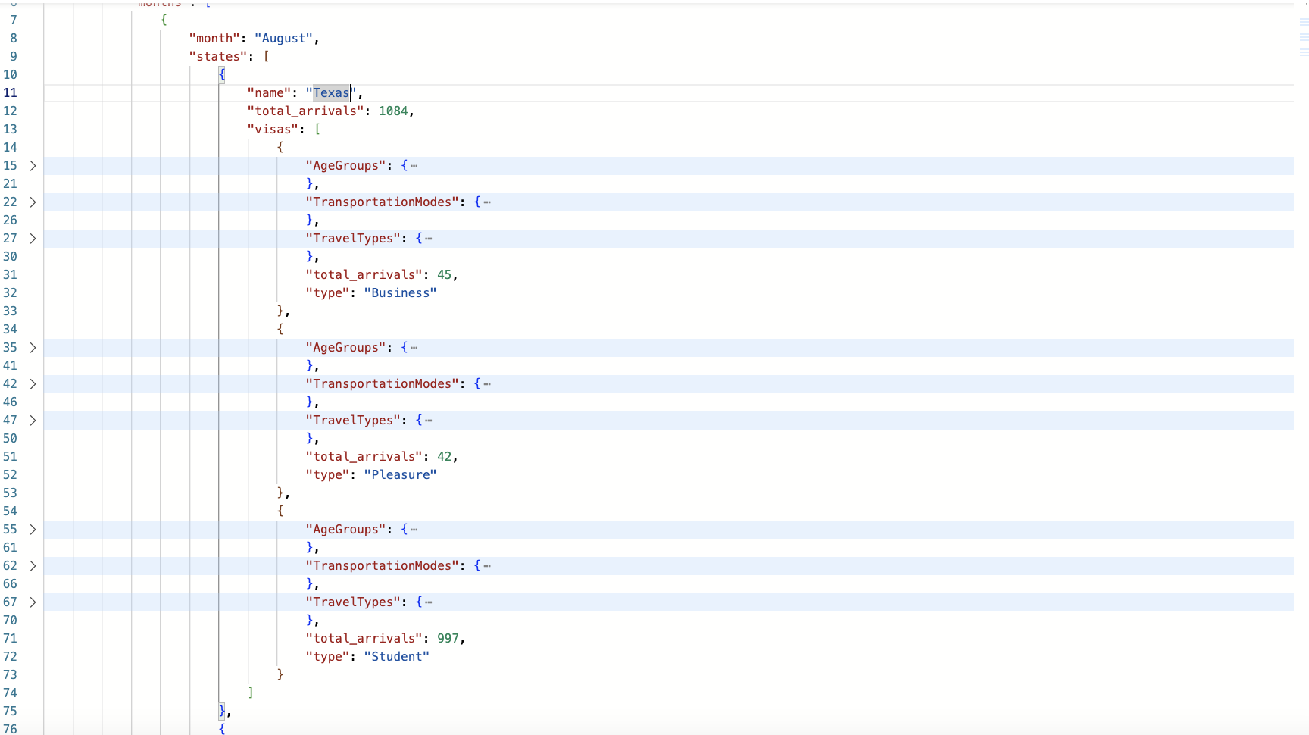
Azure Cosmos DB – Document Data Model

Slide 8
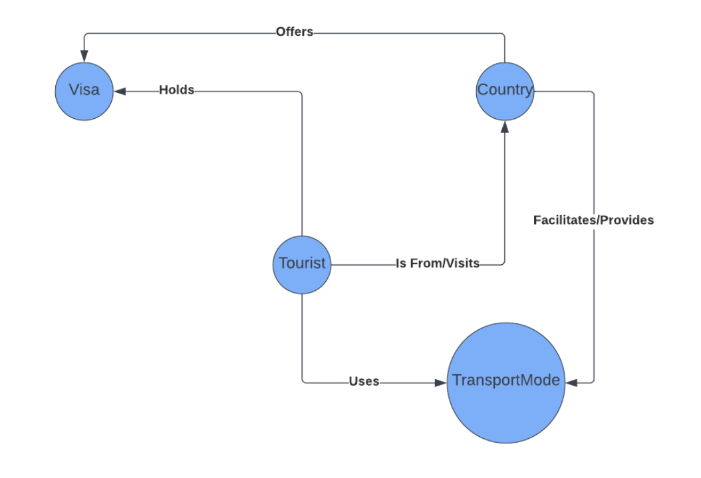
Azure Cosmos DB – Graph Data Model

Slide 9
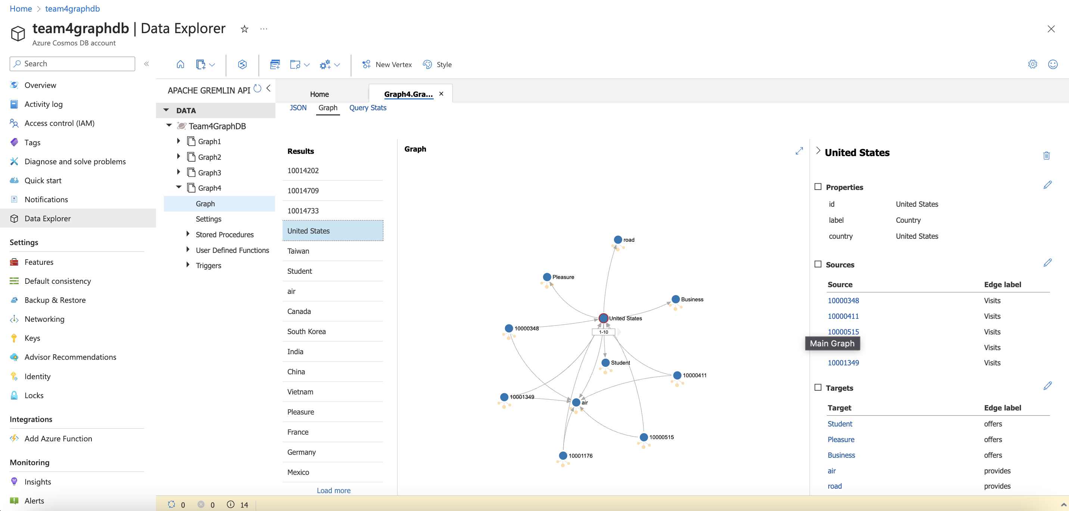
Azure Cosmos DB – Graph Data Model

Slide 10
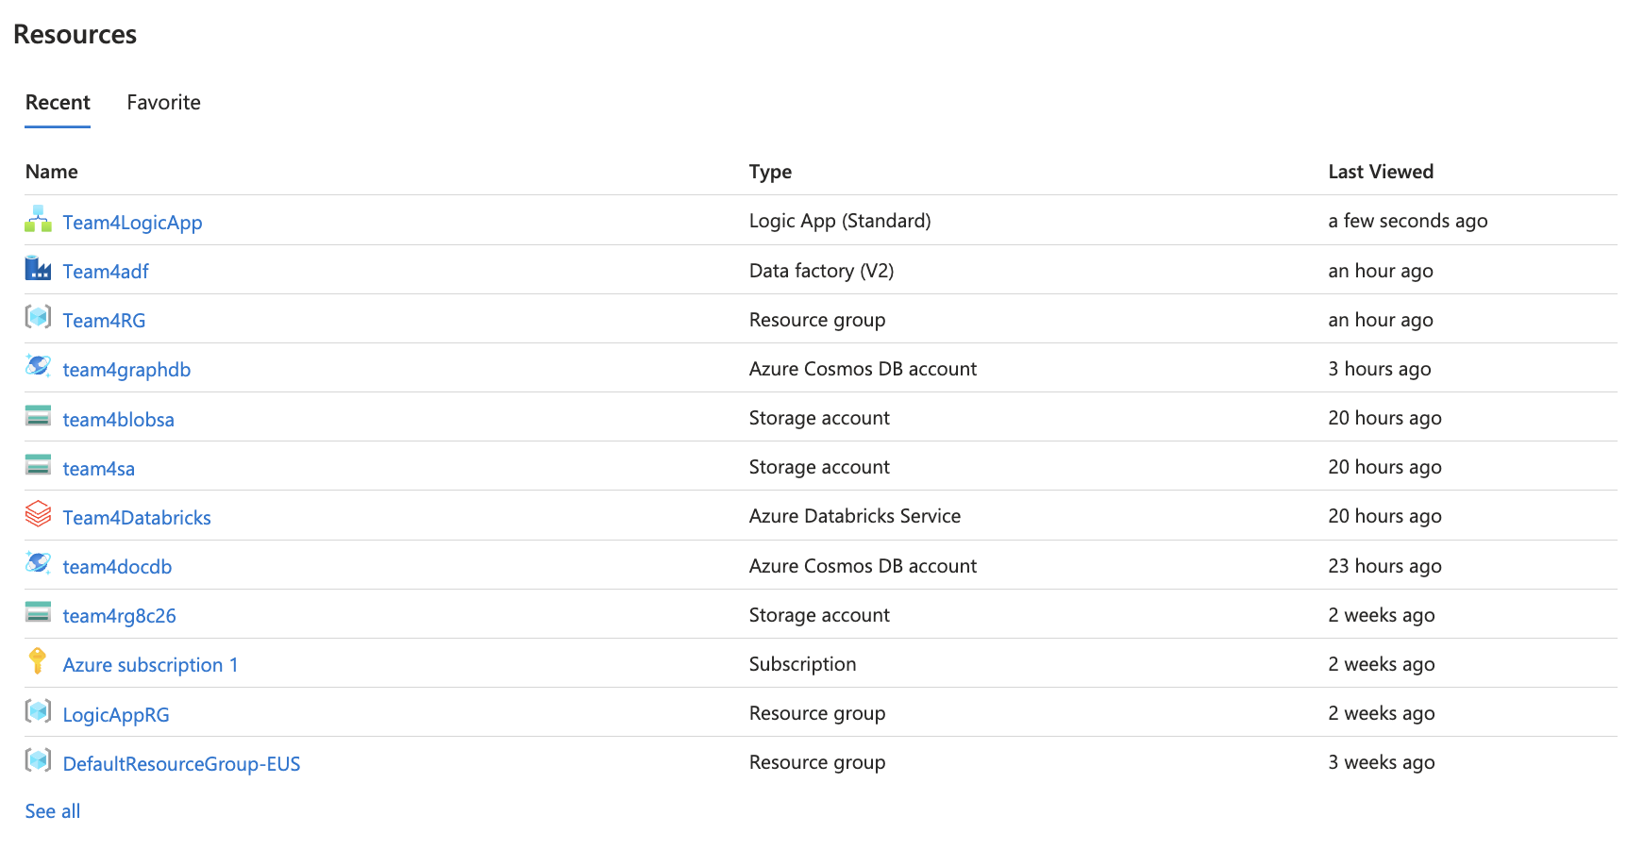
Azure Services

Slide 11
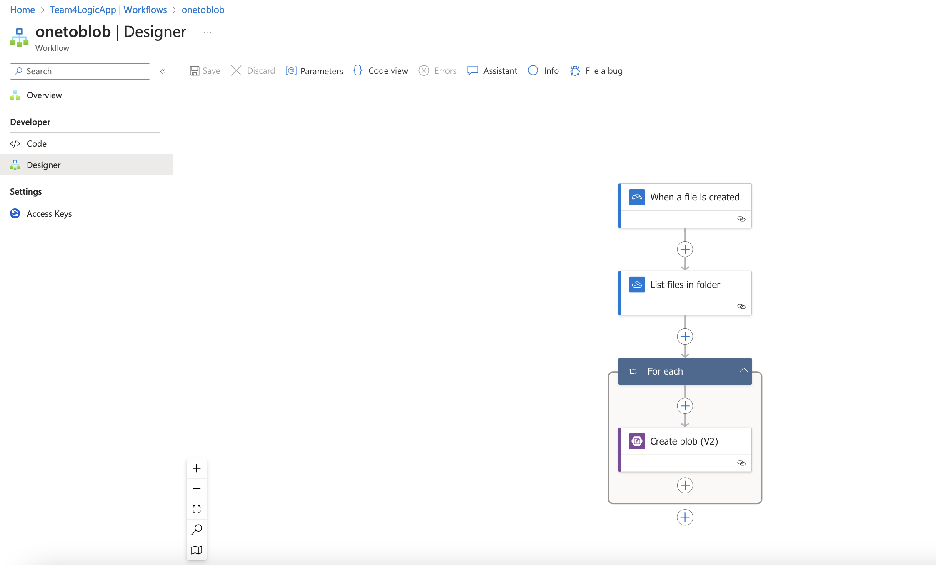
Logic Apps Flow

Slide 12
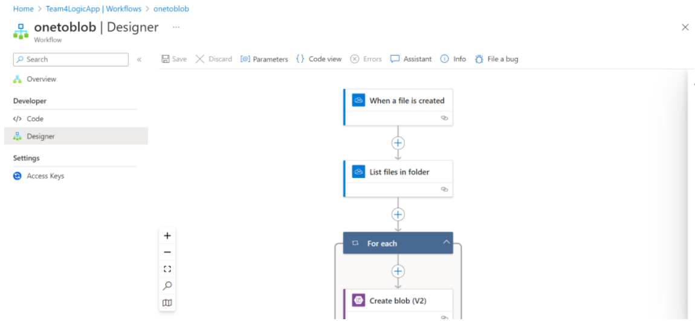
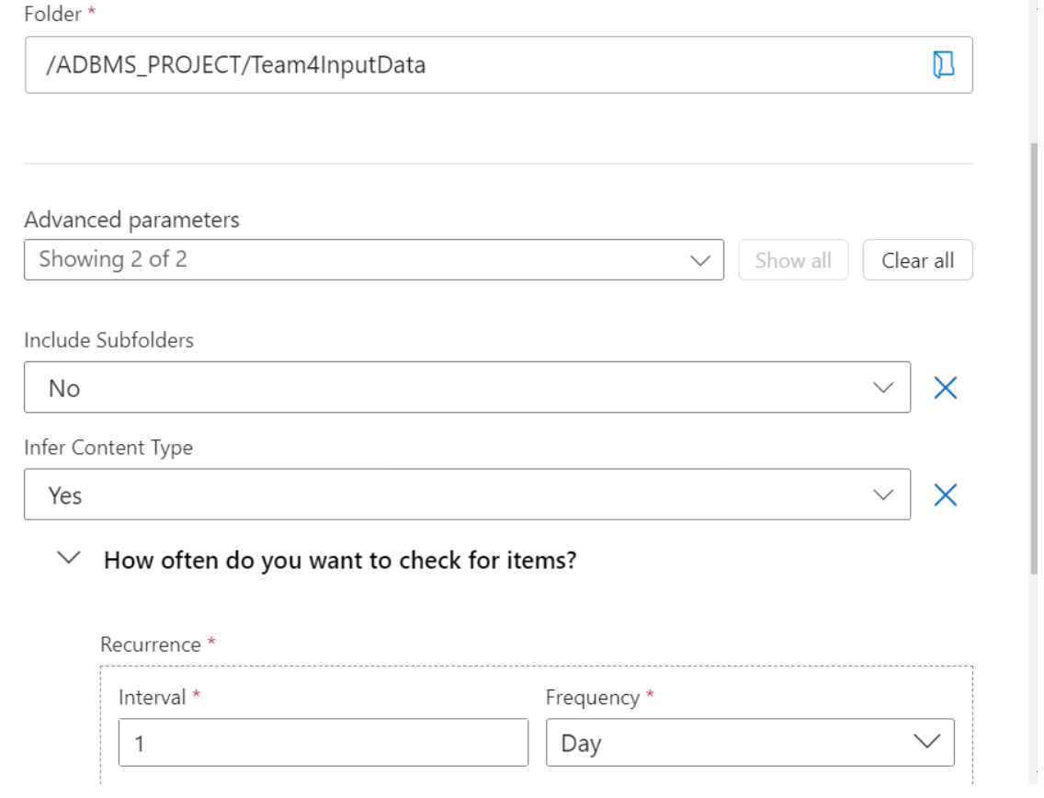
New data load trigger

Slide 13
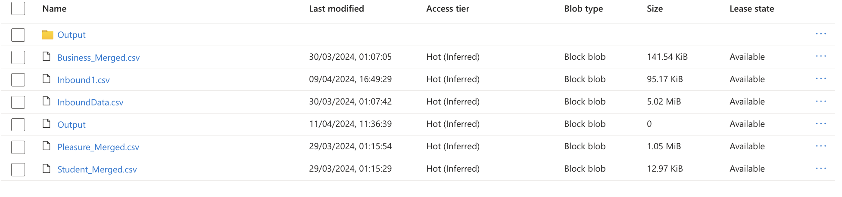
Azure Blob Containers

Slide 14
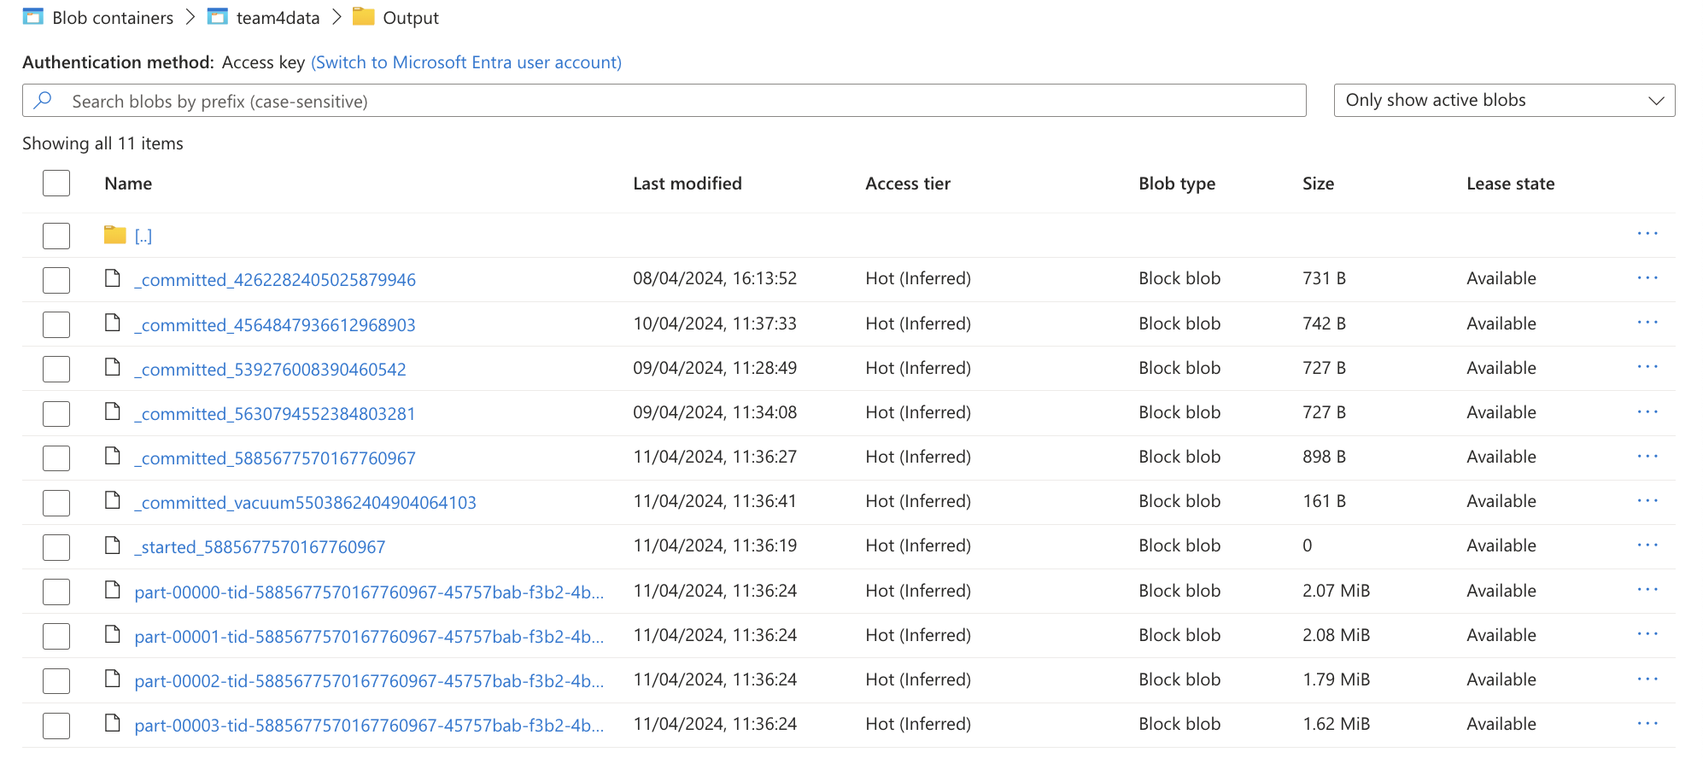
Azure Blob Containers

Slide 15
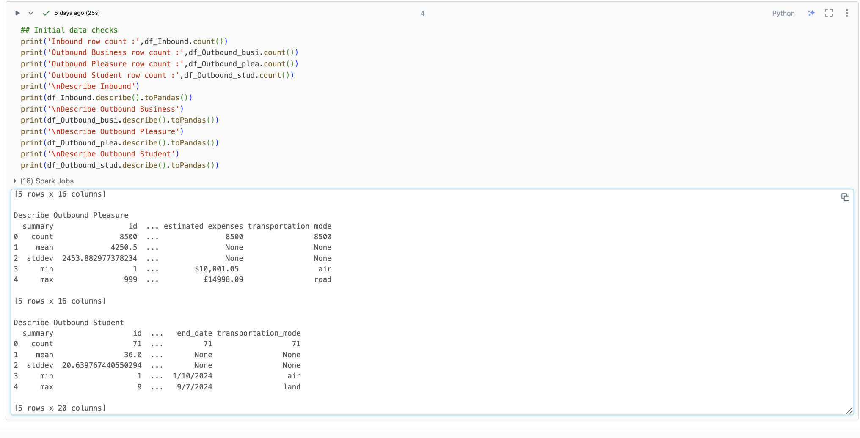
Data Cleaning

Slide 16
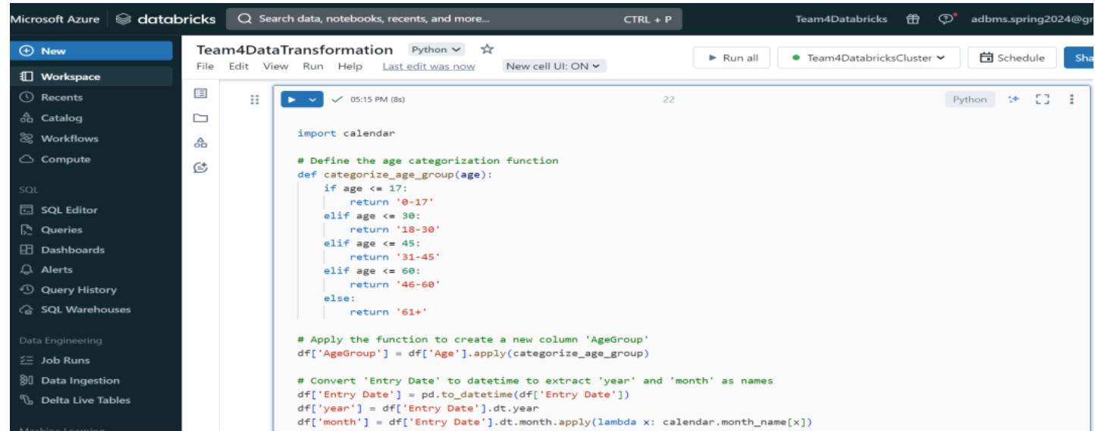
Data Cleaning

Slide 17
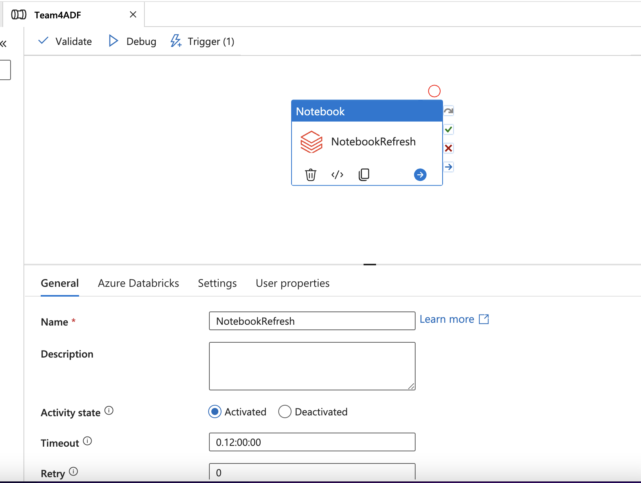
Azure Data Factory Pipeline

Slide 18
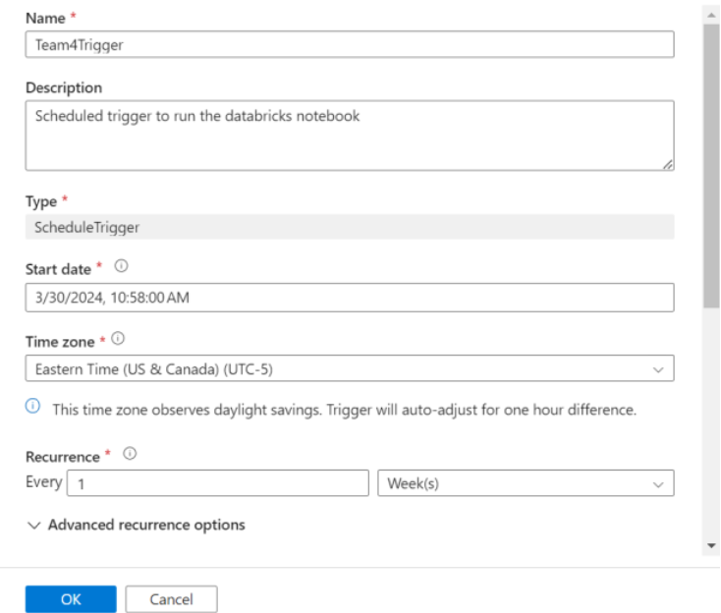
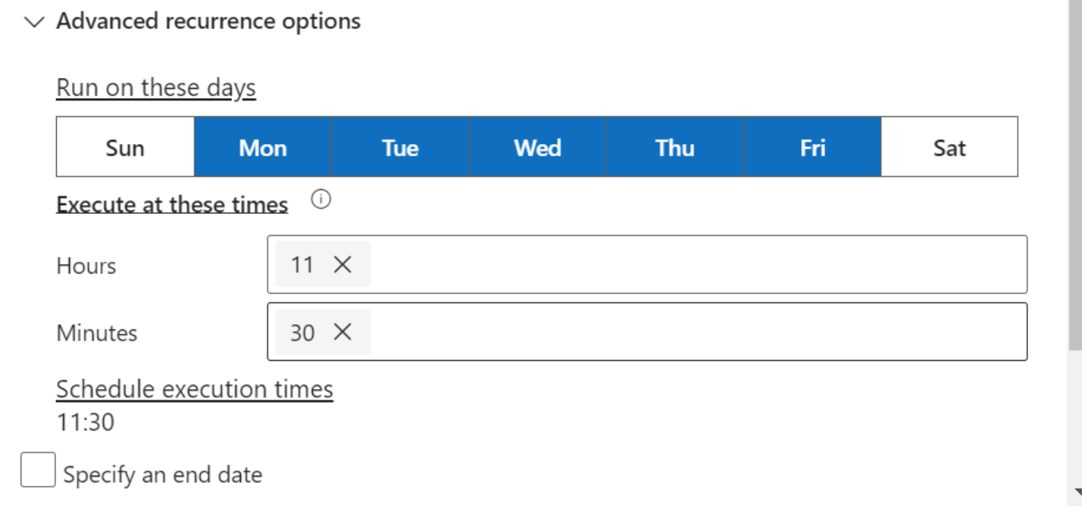
Data refresh trigger

Slide 19
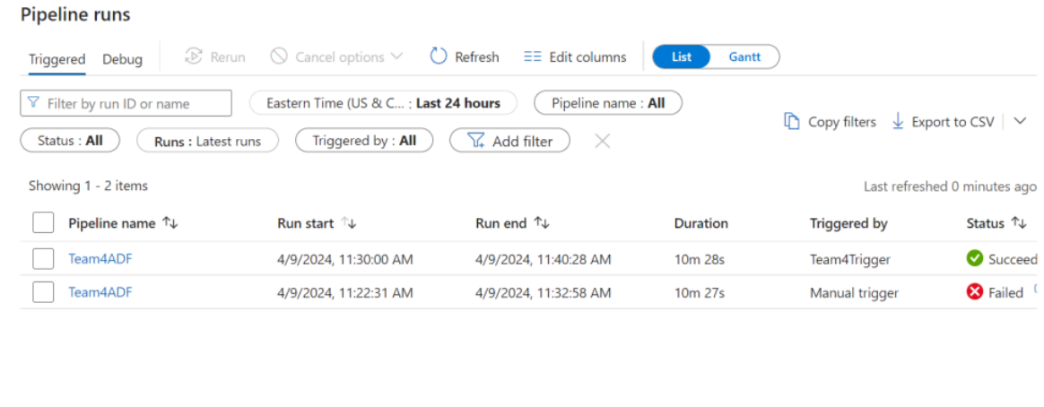
Data refresh trigger

Slide 20
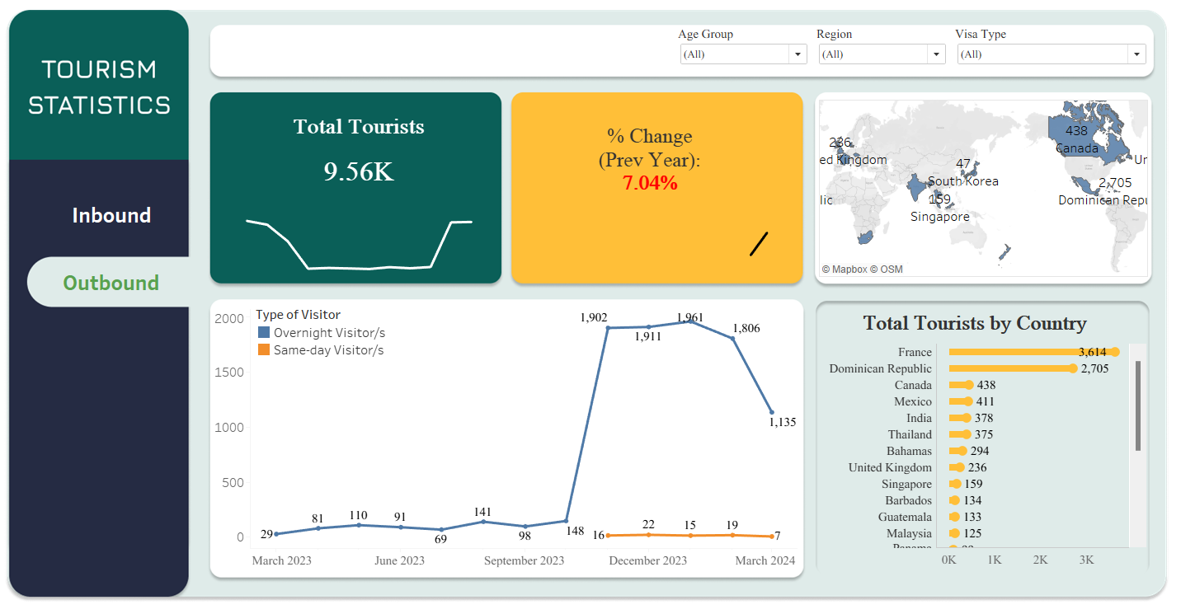
Visualization – Outbound Tourism

Slide 21
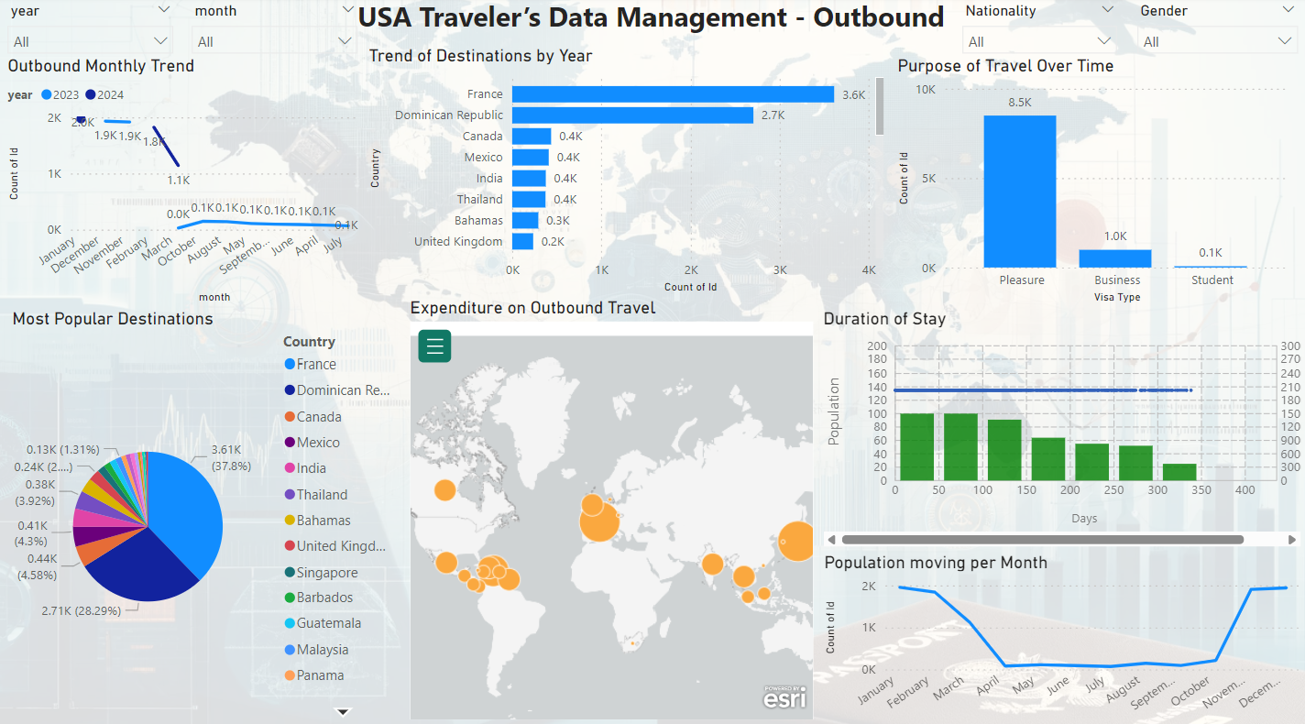
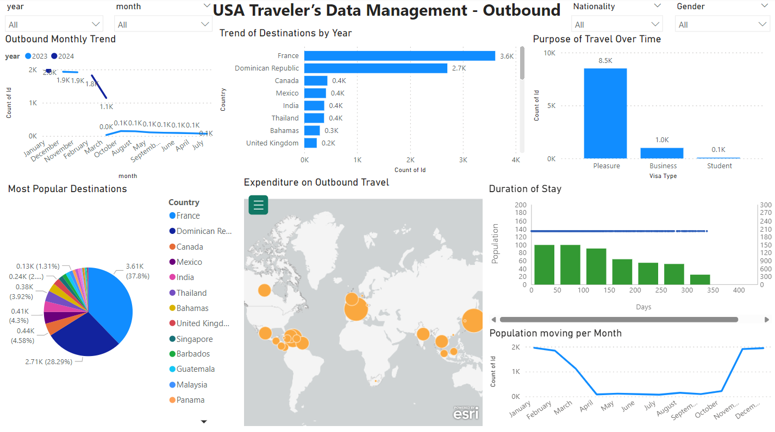
Visualization - Outbound

Slide 22
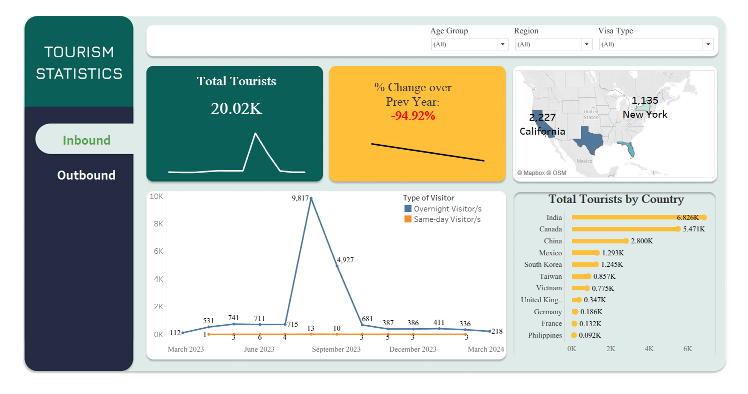
Visualization – Inbound Tourism

Slide 23
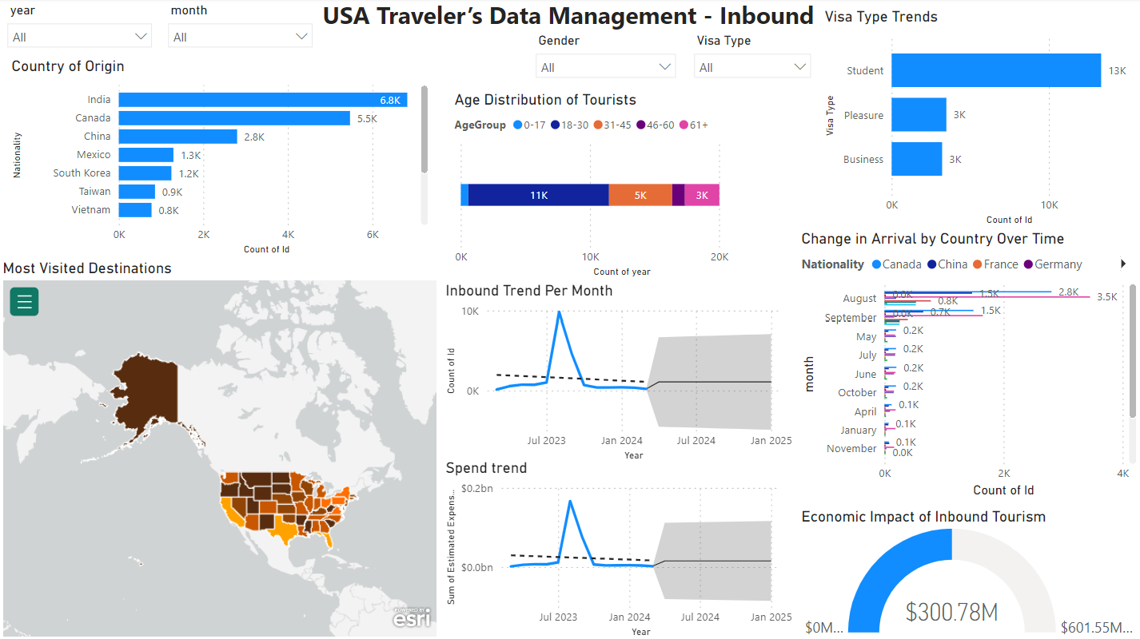
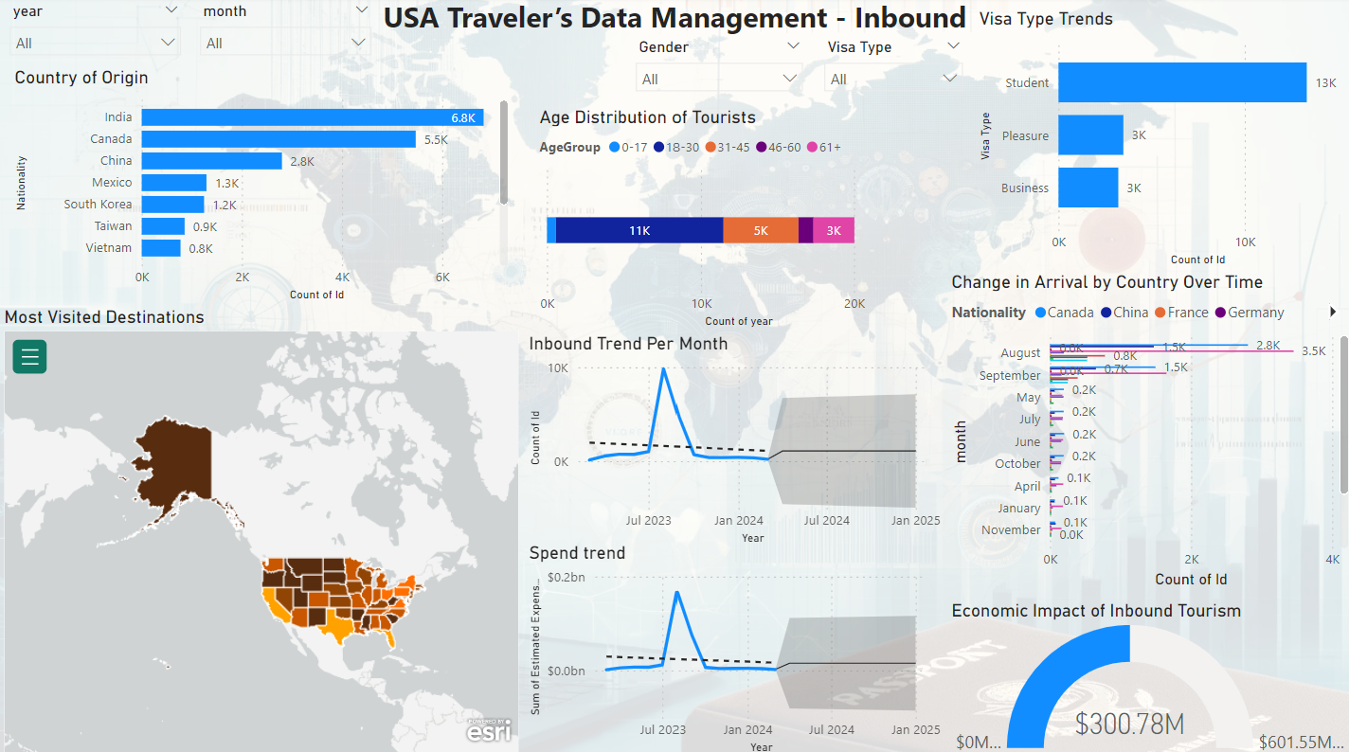
Visualization - Inbound

Slide 24
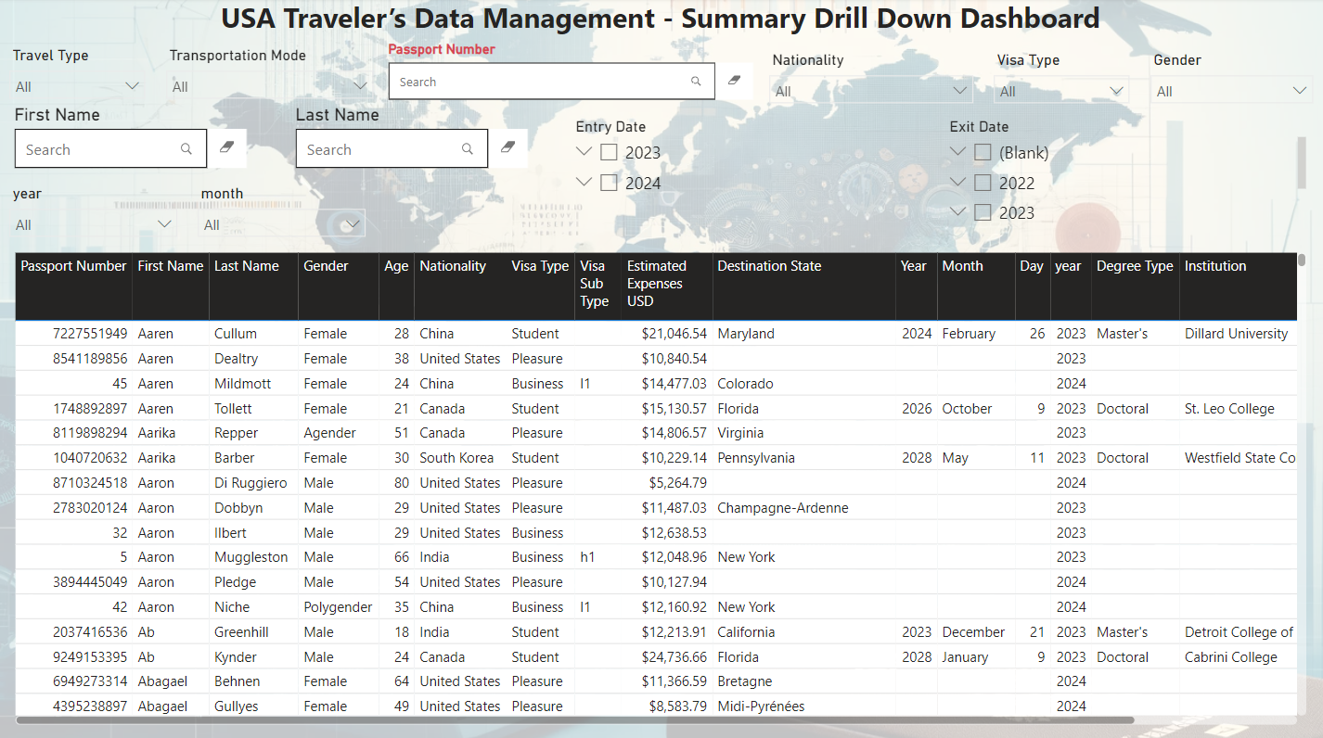
Visualization - Summary

Slide 25
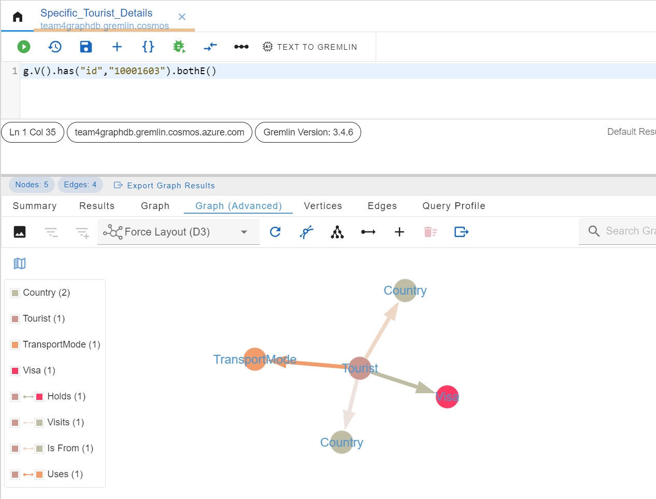
Visualization – Graph Data Model

Slide 26
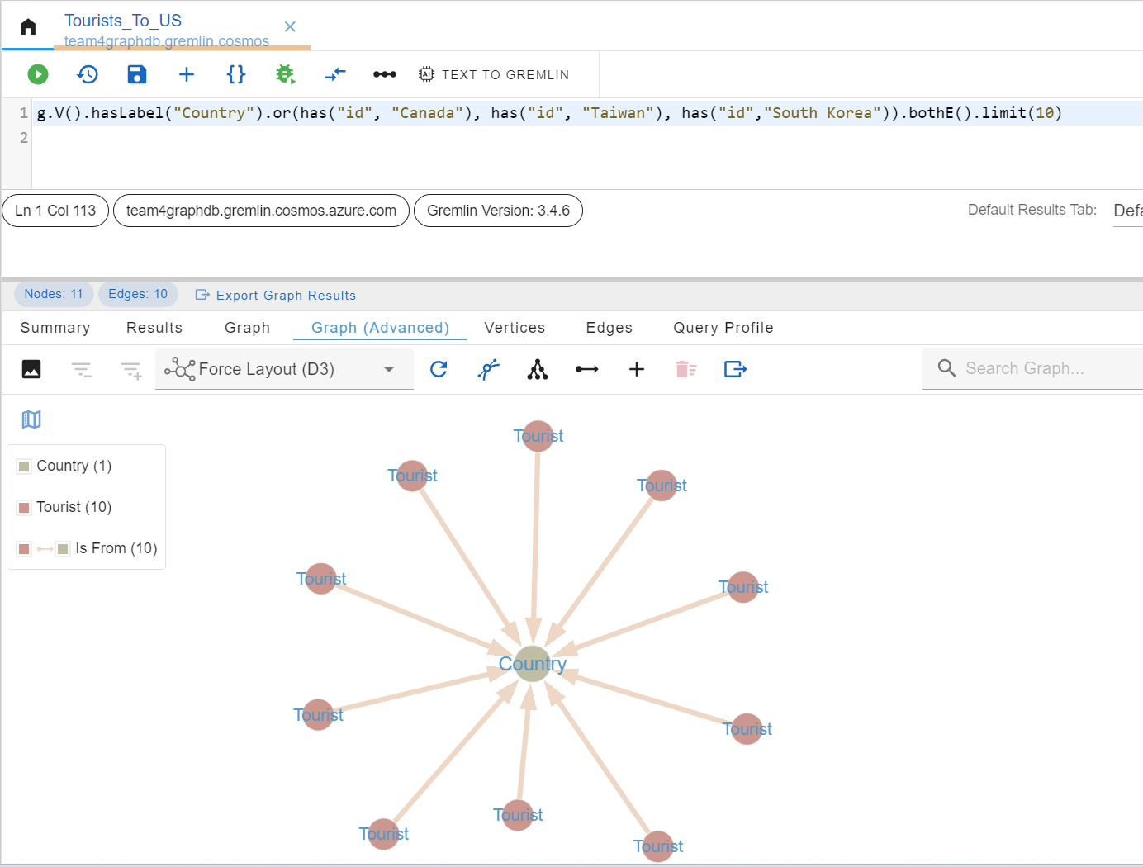
Visualization – Graph Data Model

Slide 27
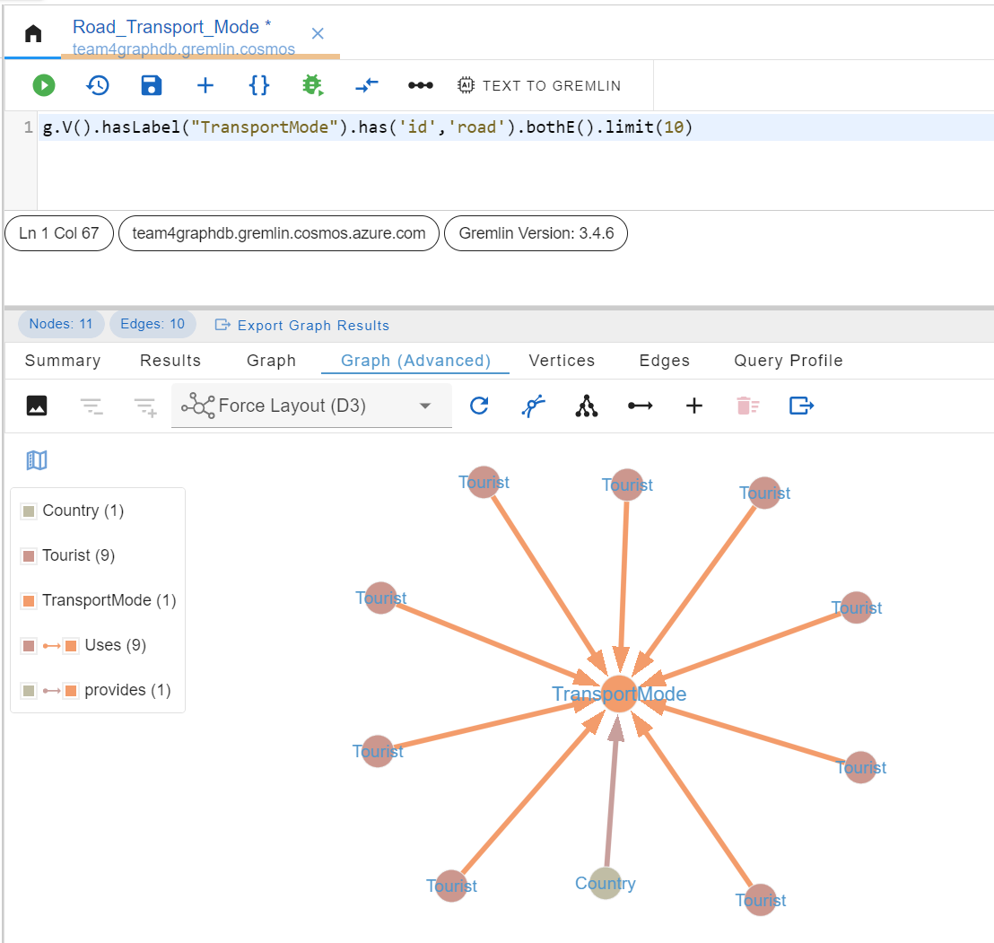
Visualization – Graph Data Model

Slide 28
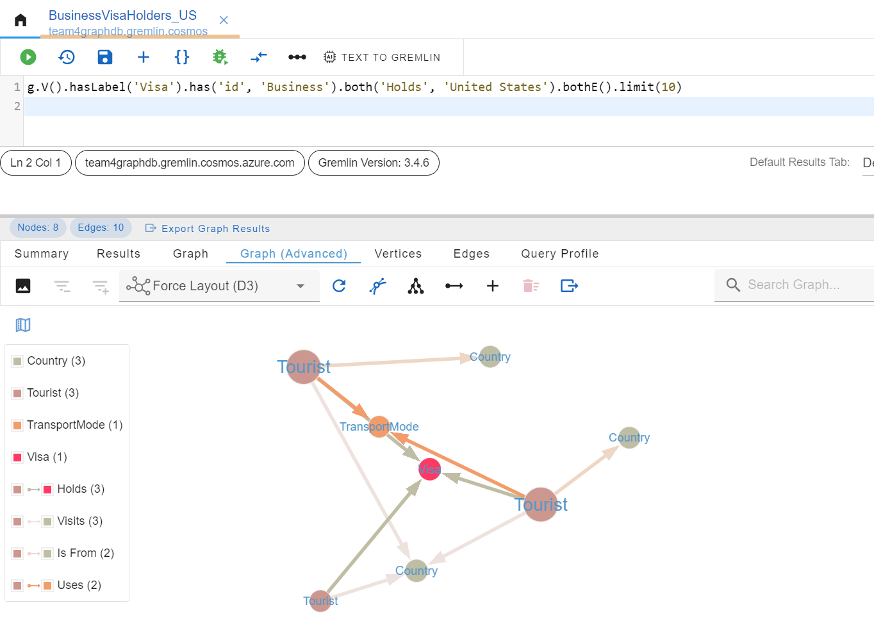
Visualization – Graph Data Model

Slide 29

Q & A??

